Slide 1
How can I see my withdrawal balance?

Slide 2
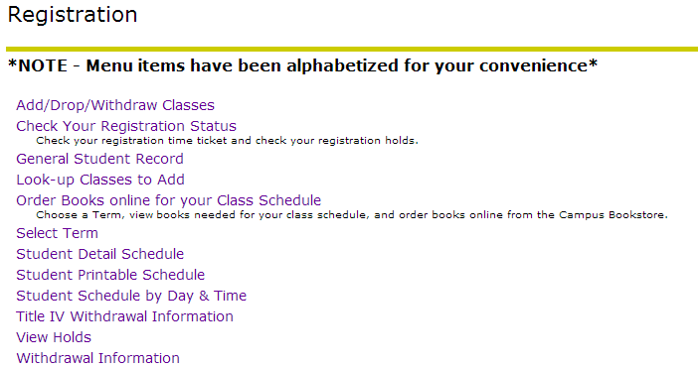
Banner Self-Service
Registration Menu

Slide 3
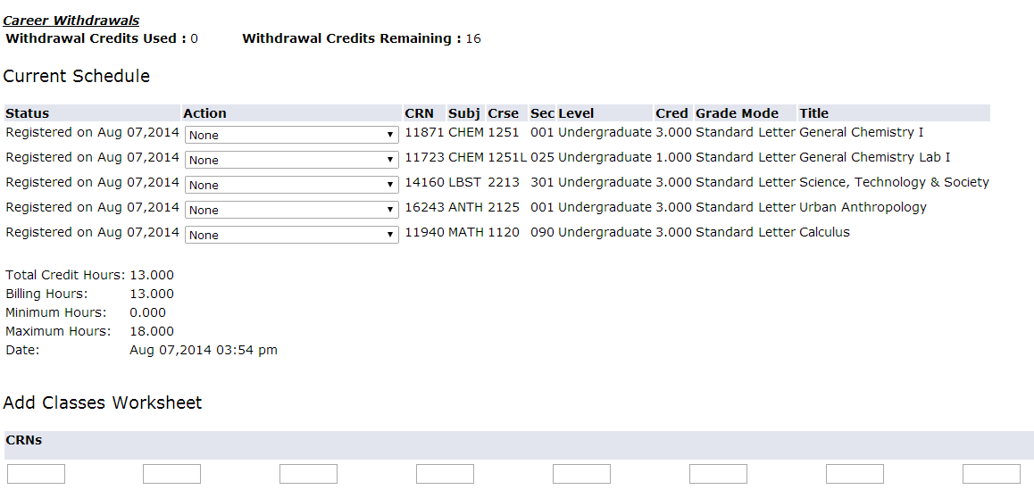
Add/Drop/Withdraw Classes Page

Slide 4
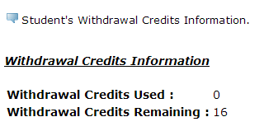
Withdrawal Information Page

Slide 5
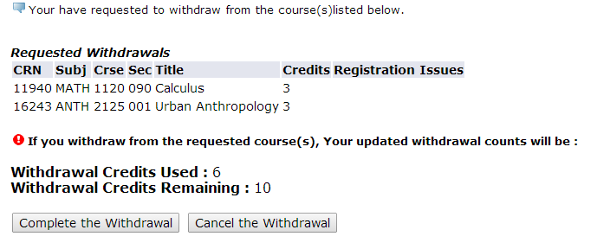
Withdrawal Confirmation Page

Slide 6
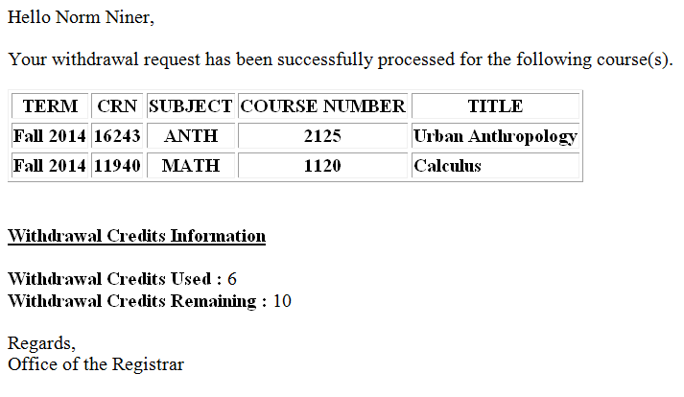
Confirmation Email

Slide 7
Questions?
Contact your advisor
http://advising.uncc.edu/students/my-advisor/finding-my-advisor
Review the Withdrawal Policy
http://provost.uncc.edu/withdrawals

